Slide 1
PREDICTING CREDIT RISK IN THE GERMAN CREDIT SYSTEM
Casey Stusynski | John Anokye | Danielle Burkett
Sanchi Srivastava | Evan Ringel | Vernice Tanquerido

Slide 2
INTRODUCTIONS

Slide 3
EXECUTIVE SUMMARY
Goal/motivation
To address challenges in credit risk assessment specific to the German financial landscape, considering cultural and regulatory nuances
Method/Data
Utilizing the German Credit dataset, our structured data analytics process included preprocessing and preparation, model prediction, training, and evaluation, parameter tuning and feature engineering, and making predictions and model comparisons.
Findings
Our analysis revealed that Neural Network, Logistic Regression, and Decision Tree models consistently demonstrated high performance, with Neural Network outperforming others even after data transformation. These models effectively classified credit applicants as “Good” or “Bad”.
Recommendations/ Conclusion
The discussion on implications for the banking sector highlights the staggering potential losses from credit risk, emphasizing the need for effective credit risk assessment. Our models, especially the Neural Network, offer a promising approach to reduce loan defaults and increase profits by identifying high-risk applicants.

Slide 4
INTRODUCTION
BUSINESS PROBLEM
STAKEHOLDERS
Extending credit to high-risk customers can lead to significant financial loss, reputation damage, and potential business loss.
Financial Institutions and potential borrowers
MOTIVATION
OPPORTUNITY/CHALLENGE
This project will leverage the German financial system as a case study, utilizing a dataset from Professor Dr. Hans Hofmann of the University of Hamburg (1994).
For lenders, this can be an opportunity to take a critical look at what the model produces as indicators for creditworthiness.
Challenge: These models are only as good as the inputs that we give them. There may be other factors that are linked to creditworthiness.
ACTION PLAN
Our action plan involves conducting a literature review on data mining techniques, selecting appropriate models for this specific domain, and preparing the data obtained from the UCI repository for analysis.

Slide 5
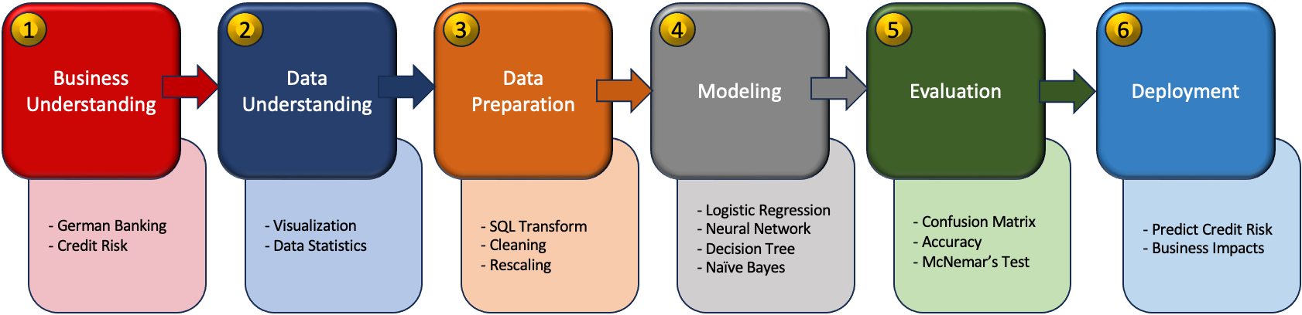
RESEARCH PROCESS

Slide 6
DATA SUMMARY
20
Attributes
1,000
Records
Binomial
Prediction Classification

Slide 7
DATASET
Attributes and Descriptions
No . | Attribute Name | Type | Category | Description
1 | Checking Account | Categorical | Financial | Status of existing checking account (DM = Deutsche Mark) < 0 DM, 0 to < 200 DM >= 200 DM/salary assignments for at least 1 year no checking account
2 | Credit History |  |  | History of credit repayments no credits taken/all credits paid back duly all credits at this bank paid back duly existing credits paid back duly until now delay in paying off in the past critical account/other credits existing (not at this bank)
3 | Savings Account/Bond |  |  | Total of applicant's cash holdings in savings and bonds (DM = Deutsche Mark) < 100 DM 100 to < 500 DM 500 to < 1000 DM >= 1000 DM unknown/no savings account)
4 | Other Installment Plans |  |  | Existing installment commitments bank stores none
 |  |  |  | Type of loan applied for car (used) car(new) furniture/equipment radio/television domestic appliances repairs education vacation retraining business others
5 | Purpose |  |  | Type of loan applied for car (used) car(new) furniture/equipment radio/television domestic appliances repairs education vacation retraining business others

Slide 8
DATASET
Attributes and Descriptions
No . | Attribute Name | Type | Category | Description
6 | Property | Categorical | Financial | Types of property owned real estate if not real estate: building society savings agreement/life insurance if not real estate or building society savings agreement/life insurance: car or other not in attr. 6 unknown/no property
7 | Other Debtors/ Guarantors |  |  | Additional debtors, complaints, or guarantors none co-applicant guarantor
8 | Present Employment |  | Employment | Duration of current employment Unemployed < 1 year 1 to < 4 years 4 to < 7 years >= 7 years
9 | Job |  |  | Status and level unemployed/unskilled - non-resident unskilled – resident skilled employee/official management/self-employed/highly-qualified employee/officer
10 | Foreign Worker |  |  | Foreign worker status yes no
11 | Personal Status |  | Demographic | Gender and marital status application male: divorced/separated female: divorced/separated/married male: single male: married/widowed female: single

Slide 9
DATASET
Attributes and Descriptions
No . | Attribute Name | Type | Category | Description
12 | Housing |  |  | Housing status rent own free
13 | Telephone |  |  | Status of telephone none yes, registered under the customer's name
14 | Duration | Numerical | Financial | Duration of loan payments in months
15 | Credit Amount |  |  | Amount of credit applied for in DM (DM = Deutsche Mark)
16 | Existing Credits at a Bank |  |  | Number of existing credit accounts at bank
17 | Installment Rate |  |  | Installment rate as % of disposable income

Slide 10
DATASET
Attributes and Descriptions
No . | Attribute Name | Type | Category | Description
18 | Present Residence Since | Numerical | Demographic | Duration of years in current residence
19 | Age |  |  | Age in years
20 | Number of People to Provide Maintenance for |  |  | Number of dependents
21 | Good or Bad Credit | Categorical/Binomial |  | 1 = Good, 2 = Bad

Slide 11
DATA PREPROCESSING AND PREPARATION
DATA TRANSFORMATION/ EXPLORATORY ANALYSIS
loaded the first dataset (containing categorical and symbolic attributes) into SQL Server for transformation and exploratory analysis. We created a legend/mapping from the Word doc provided in the UCI dataset that maps each attribute category and symbol to attribute values.
Handling Missing Data, OUTLIERS AND ANOMALIES
No missing data or anomalies were found in the dataset.
Data Normalization
As a general best practice and to avoid model issues such as overfitting and bias, we have normalized the numeric attributes to ensure equal weights are used during prediction.
Data Correlation
The highest correlation between any two attributes was 0.625. This correlation was between the duration of the loan and the amount of the loan. We felt that this correlation was not high enough to warrant removing one of these attributes.

Slide 12
Model Results and Interpretation

Slide 13
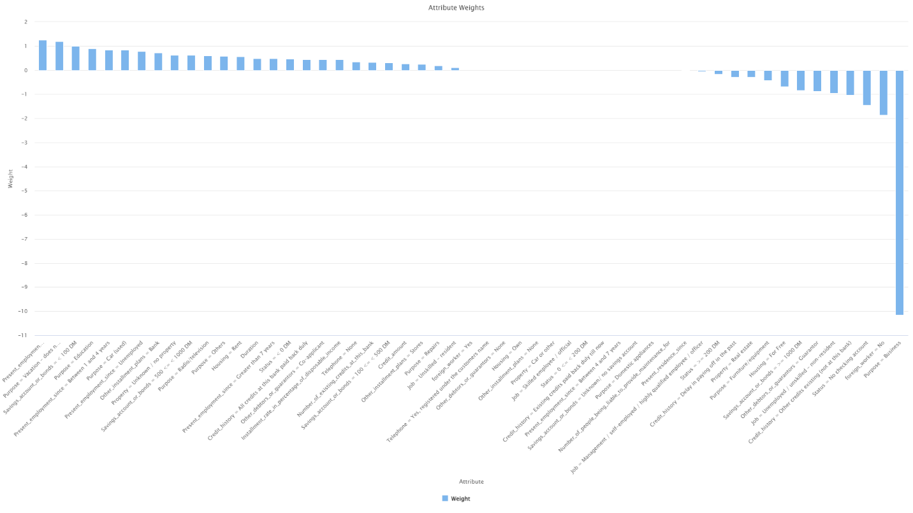
LOGISTIC REGRESSION IN RM AND R

Slide 14
Logistic Regression Model Results in R
Logistic Regression Confusion Matrix
Prediction | 0 | 1
0 | 187 | 46
1 | 29 | 38
Model Statistics
Accuracy | 0.75
95% CI | (0.697, 0.798)
No Information Rate | 0.72
P-Value [Acc>NIR] | 0.13674
Kappa | 0.3391
McNemar’s Test P-Value | 0.06467
Sensitivity | 0.8657
Specificity | 0.4524
Pos Pred Value | 0.8026
Neg Pred Value | 0.5672
Prevalence | 0.7200
Detection Rate | 0.6233
Detection Prevalence | 0.7767
Balanced Accuracy | 0.6591
‘Positive’ Class | 0

Slide 15
DECISION TREE ANALYSIS IN RM
Duration > 3.690: 1 {0=0, 1=1}
Duration ≤ 3.690
| Credit_amount > 2.731
| | Credit_amount > 4.458: 0 {0=1, 1=0}
| | Credit_amount ≤ 4.458
| | | Credit_history = All credits at this bank paid back duly
| | | | Purpose = Car (used): 0 {0=1, 1=0}
| | | | Purpose = Furniture/equipment: 1 {0=0, 1=1}
| | | Credit_history = Delay in paying off in the past: 0 {0=3, 1=0}
| | | Credit_history = Existing credits paid back duly till now: 1 {0=0, 1=13}
| | | Credit_history = Other credits existing (not at this bank)
| | | | Duration > 2.706: 0 {0=1, 1=0}
| | | | Duration ≤ 2.706
| | | | | Credit_amount > 2.875: 1 {0=0, 1=3}
| | | | | Credit_amount ≤ 2.875: 0 {0=1, 1=0}
| Credit_amount ≤ 2.731: 0 {0=521, 1=192}

Slide 16
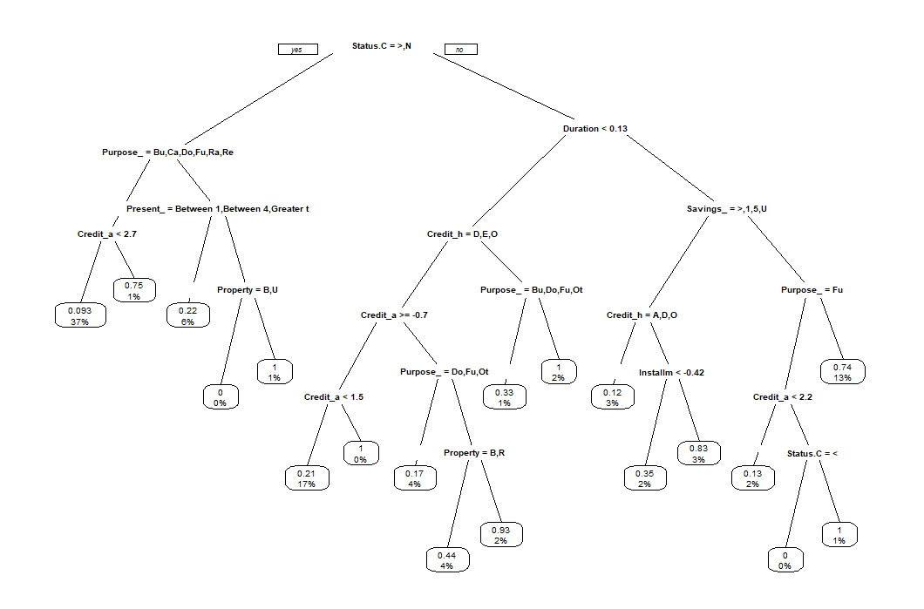
DECISION TREE ANALYSIS IN R

Slide 17
Logistic Regression Model Results in R
Decision Tree Confusion Matrix
Prediction | 0 | 1
0 | 193 | 49
1 | 23 | 35
Model Statistics
Accuracy | 0.76
95% CI | (0.7076, 0.8072)
No Information Rate | 0.72
P-Value [Acc>NIR] | 0.067970
Kappa | 0.3426
McNemar’s Test P-Value | 0.003216
Sensitivity | 0.8935
Specificity | 0.4167
Pos Pred Value | 0.7975
Neg Pred Value | 0.6034
Prevalence | 0.7200
Detection Rate | 0.6433
Detection Prevalence | 0.8067
Balanced Accuracy | 0.6551
‘Positive’ Class | 0

Slide 18
Naïve Bayes Analysis in RM and R
Class 1 (Good) | Class 2 (Bad)
0.715 | 0.285
19 distributions | 19 distributions

Slide 19
NEURAL NETWORK Model Results in R
Naïve Bayes Confusion Matrix
Prediction | 0 | 1
0 | 184 | 43
1 | 32 | 41
Model Statistics
Accuracy | 0.75
95% CI | (0.697, 0.798)
No Information Rate | 0.72
P-Value [Acc>NIR] | 0.1367
Kappa | 0.3541
McNemar’s Test P-Value | 0.2482
Sensitivity | 0.8519
Specificity | 0.4881
Pos Pred Value | 0.8106
Neg Pred Value | 0.5616
Prevalence | 0.7200
Detection Rate | 0.6133
Detection Prevalence | 0.7567
Balanced Accuracy | 0.6700
‘Positive’ Class | 0

Slide 20
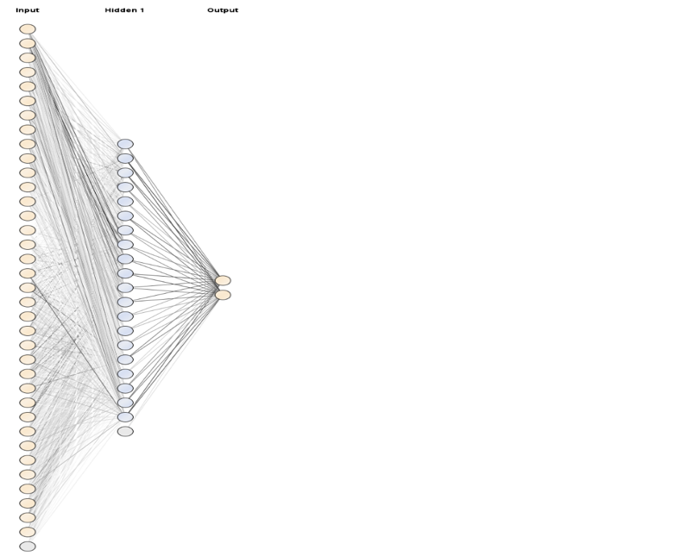
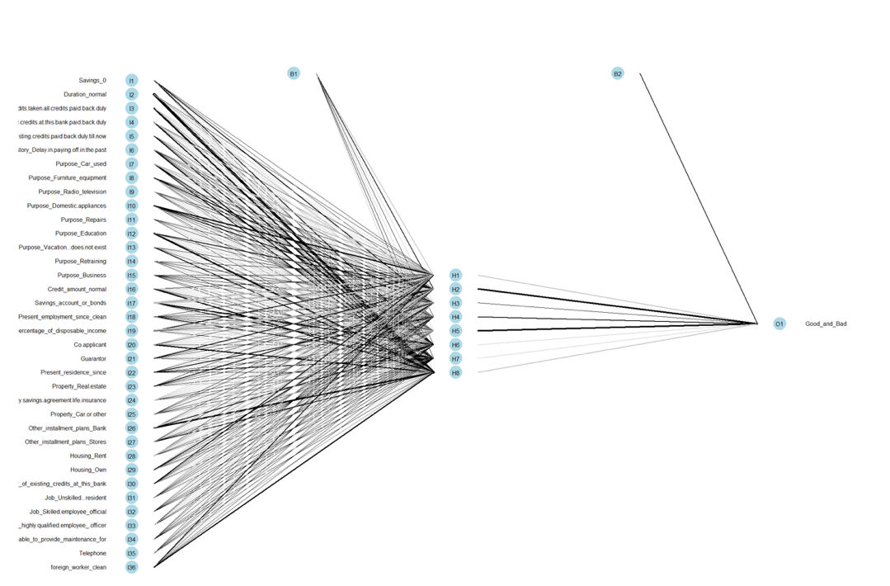
Neural Network Model in RM AND R

Slide 21
NEURAL NETWORK Model Results in R
Neural Network Confusion Matrix
Prediction | 0 | 1
0 | 46 | 35
1 | 46 | 173
Model Statistics
Accuracy | 0.73
95% CI | (0.676, 0.7794)
No Information Rate | 0.6933
P-Value [Acc>NIR] | 0.09323
Kappa | 0.3432
McNemar’s Test P-Value | 0.26652
Sensitivity | 0.5000
Specificity | 0.8317
Pos Pred Value | 0.5679
Neg Pred Value | 0.7900
Prevalence | 0.3067
Detection Rate | 0.1533
Detection Prevalence | 0.2700
Balanced Accuracy | 0.6659
‘Positive’ Class | 0

Slide 22
MODEL EVALUATION
RECALL
PRECISION
ACCURACY
What proportion of actual positives was identified correctly
What proportion of positive identifications was actually correct?
Overall, how often is the classifier correct?

Slide 23
MODEL EVALUATION
 | DT_R |  | DT_RM |  | LR_R |  | LR_RM |  | NN_R |  | NN_RM |  | NB_R |  | NB_RM
 | BAD | GOOD | BAD | GOOD | BAD | GOOD | BAD | GOOD | BAD | GOOD | BAD | GOOD | BAD | GOOD | BAD | GOOD
BAD | 35 | 23 | 3 | 3 | 38 | 29 | 30 | 15 | 46 | 35 | 37 | 42 | 41 | 32 | 28 | 23
GOOD | 49 | 193 | 60 | 155 | 46 | 187 | 33 | 143 | 46 | 173 | 53 | 168 | 43 | 184 | 35 | 135
Accuracy | 76.00% |  | 71.49% |  | 75.00% |  | 78.28% |  | 73.00% |  | 68.33% |  | 75.00% |  | 73.76%
Recall | 41.67% |  | 4.76% |  | 45.24% |  | 47.62% |  | 50.00% |  | 41.11% |  | 48.84% |  | 44.44%
Precision | 60.30% |  | 50.00% |  | 56.72% |  | 66.67% |  | 56.79% |  | 46.84% |  | 56.16% |  | 54.90%

Slide 24
BEST PERFORMING MODEL
NEURAL NETWORK

Slide 25
THANK YOU
Casey Stusynski
John Anokye
Danielle Burkett
Sanchi Srivastava
Evan Ringel
Vernice Tanquerido

